Slide 1


Pathways Forward
Notes:
Thank you so much for taking the time to listen to my SWOT analysis and proposed pathways forward for our organization.

Slide 2
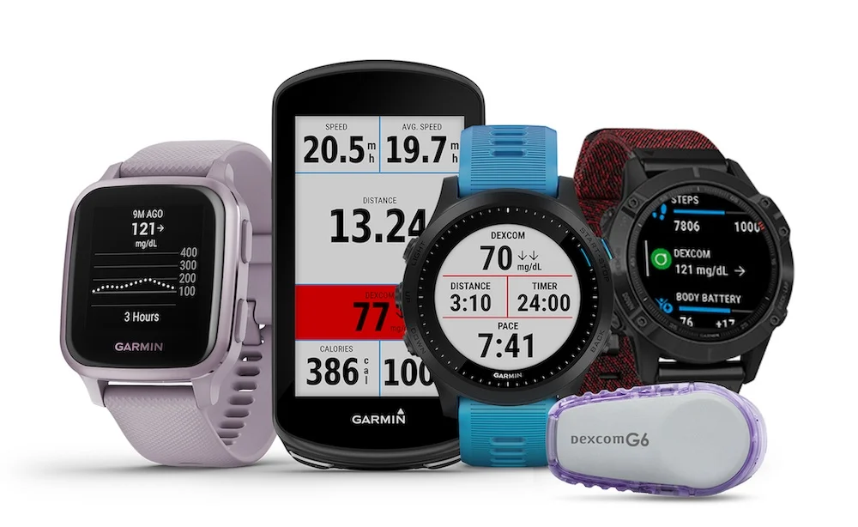
Notes:
These are some of the key aspect’s of Garmin’s past, present, and future goals that I would like to dive into. Our manufacturing strengths, our challenges with dependencies on our retail partners and inventory management, opportunities to develop synergies and strategic technological partnership opportunities, and the very real impact of shipping costs, cyber attacks and competitors.

Slide 3
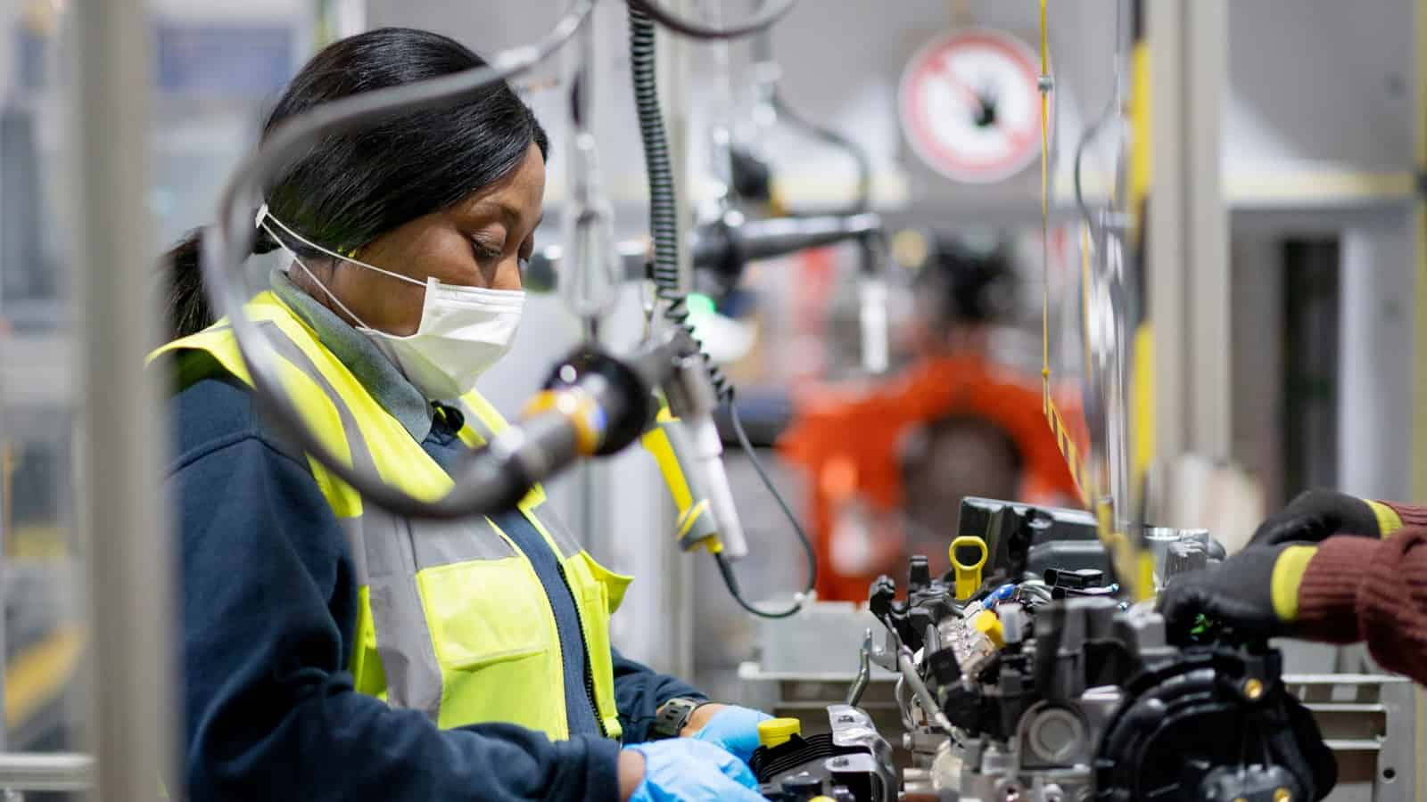
Notes:
Lets be real, we know where we shine –
Vertical Integration
Our distribution networks
And our Diverse Product Market
These are the places where we are industry leaders

Slide 4
Notes:
One of our core competencies and strengths is our vertically integrated manufacturing capabilities at our facilities in Taiwan, China, our Netherlands, our Poland facility and our U.S. facilities in Olathe, Kansas and Salem, Oregon.
To this end, I believe that our ownership and operation of our own manufacturing facilities and distribution networks provides significant capability and flexibility.

Slide 5
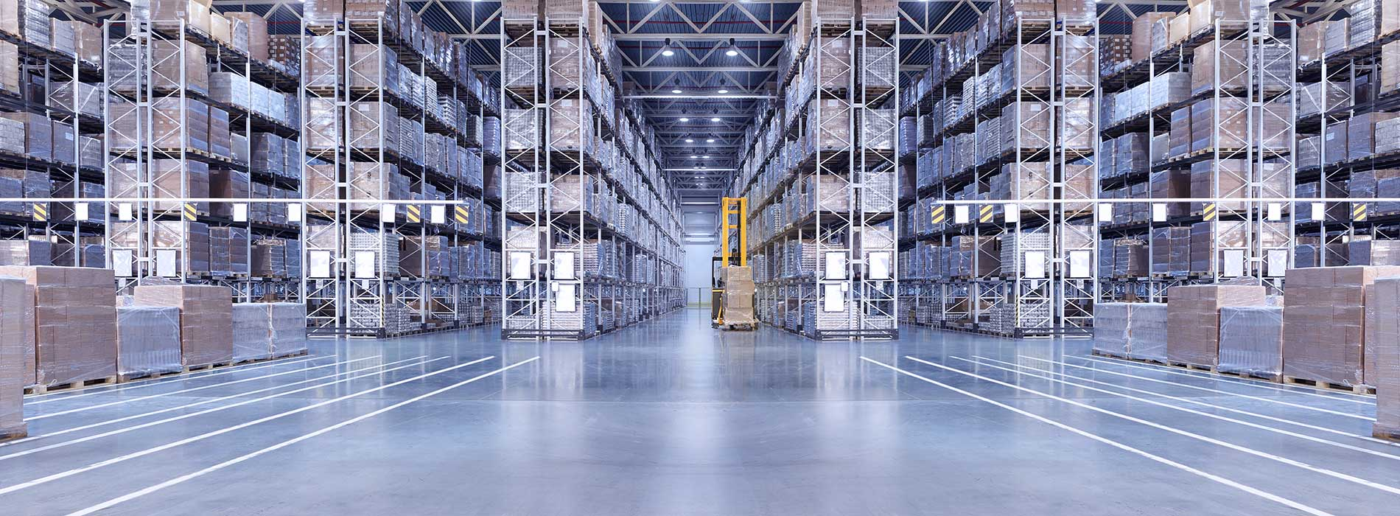
Notes:
Let's take a look at the flip side of this.
Covid-19 laid bare some fundamental weaknesses.
Economic contraction and constrained consumer and business spending has resulted in periods of decreased revenue in the past, and could in the future result in decreased revenue and problems with our ability to manage inventory levels.

Slide 6
Notes:
In addition, financial difficulties experienced by our retailers and OEM customers have resulted, and could result in the future, in significant bad debt write-offs and additions to reserves in our receivables and could have an adverse effect on our operations.

Slide 7

Notes:
Looking toward the future we must continually evaluate acquisition opportunities and opportunities to make investments in complementary businesses, technologies, services or products
Also to enter into strategic partnerships with parties who can provide access to those assets, additional product or services offerings.

Slide 8
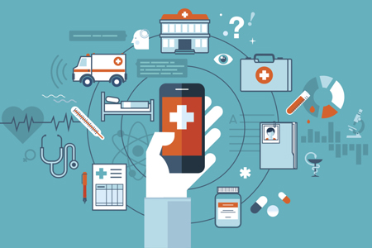
Notes:
Imagine for a minute that you’ve completed a long workout .
Being an avid cyclist and runner, you are always aware if your performance is insufficient. So, when you feel a little bad after your workout you have reason to worry.
Concerned that there may be something wrong with you, your information is transferred from your watch to a healthcare institution of your choice.
This information is placed into an advanced algorithm and and an initial assessment is made of your health condition.
These results are sent back to you and an appointment is automatically made with your primary healthcare provider. This is simultaneously added to your calendar. Ladies and gentlemen, IOT is the future.

Slide 9
Notes:
According to iot-analytics.com - In 2021, IoT Analytics expects the global number of connected IoT devices to grow 9%, to 12.3 billion active endpoints. By 2025, there will likely be more than 27 billion IoT connections.

Slide 10

Notes:
Finally, let's take a look at the Threats.
The markets for many of our products are highly competitive, and we expect competition to increase in the future.
Manufacturing and freight costs pose a challenge should demand in our products drastically rise.
Cyber attacks have been and will continue to be a looming threat that negatively impact our image.

Slide 11
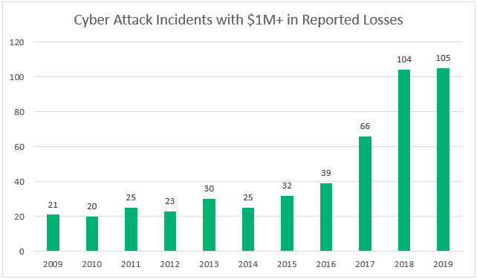
Cyber Security
Notes:
According to the Identity Theft Resource Center (ITRC) the number of publicly-reported data compromises through September 30, 2021 has exceeded the total number of events in FY 2020.
Our Company was the victim of a cyber attack that encrypted some of our systems on July 23, 2020. As a result, many of our online services were interrupted including website functions, customer support, customer facing applications, and company communications.
The biggest impact is how these attacks will reflect on our reputation.
The impact of this outage to our operations and financial results was not material, and we do not expect it to have material impacts on future periods. However, failures or disruptions, including security breaches or cyber attacks, to our information technology systems may harm our reputation and adversely affect our business and result of operations.

Slide 12
Notes:
Global shipping costs and other shifting production factors pose a significant risk as we diversify our product portfolio. If demand increases beyond what we forecast, we would have to rapidly increase production.
We would depend on suppliers to provide additional volumes of components and those suppliers might not be able to increase production rapidly enough to meet unexpected demand.

Slide 13







Competitors
Notes:
And then, of course, there's our competitors.
The markets for many of our products are highly competitive, and we expect competition to increase in the future. Some of our competitors have significantly greater financial, technical and marketing resources than we do. These competitors may be able to respond more rapidly to new or emerging technologies or changes in customer requirements. They may also be able to devote greater resources to the development, promotion and sale of their products or secure better product positioning with retailers.

Slide 14
Thank you!
Notes:
Keeping these factors in mind I’m sure we will be able to navigate the future effectively. Thank you for your time, I’m happy to field any questions.

